Slide 1
Exploiting Shape Properties for Improved Retrieval, Discrimination and Recognition
Vittal Premachandran
Thesis Defense Presentation
February 2014

Slide 2
Outline
Introduction
Background
Perceptually Motivated Shape Context
What parts of a shape are discriminative?
Shape similarity propagation on manifolds
Object detection in images using shapes
Summary

Slide 3
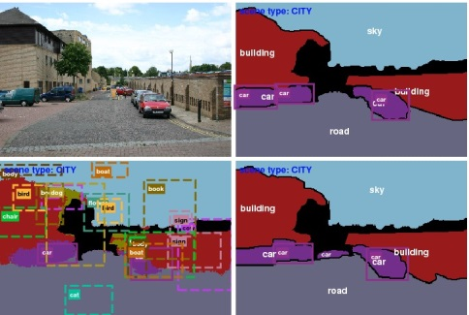
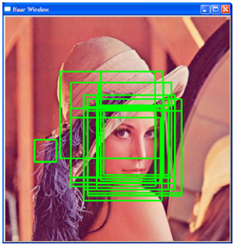
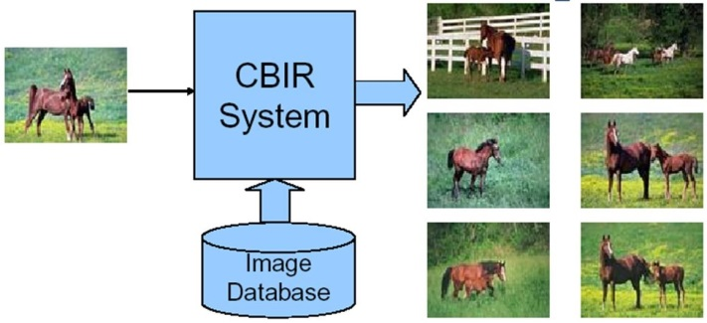
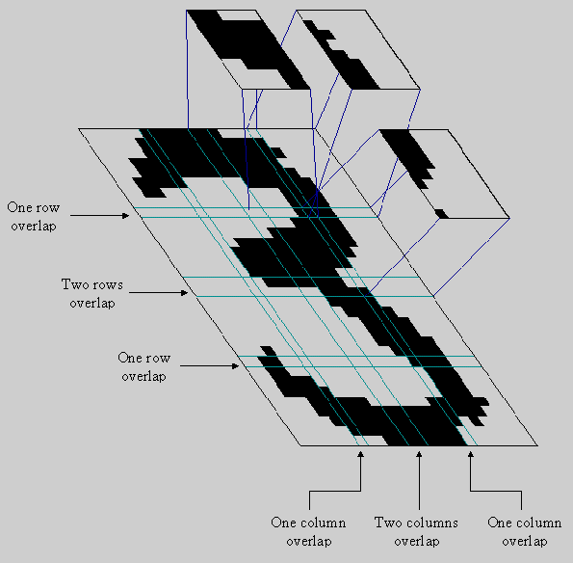
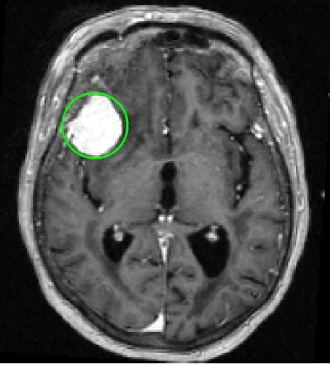
Introduction
Longstanding Goals of Computer Vision
Scene Understanding
Face Recognition
Content-Based Image Retrieval
Common Task?
Optical Character Recognition
Tumor Detection

Slide 4
Introduction
Longstanding Goals of Computer Vision
Object Recognition!
Scene Understanding
Face Recognition
Content-Based Image Retrieval
Common Task?
Optical Character Recognition
Tumor Detection

Slide 5
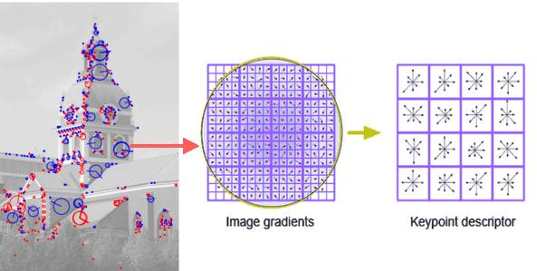
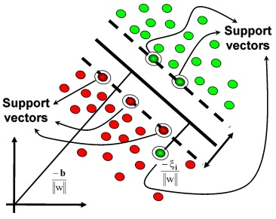


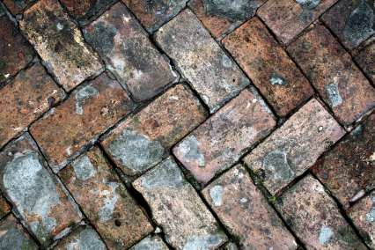
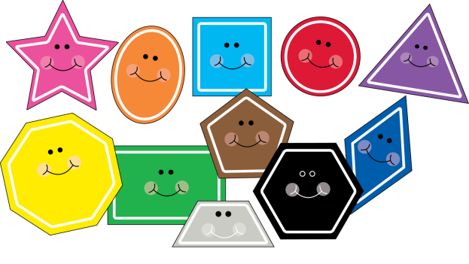
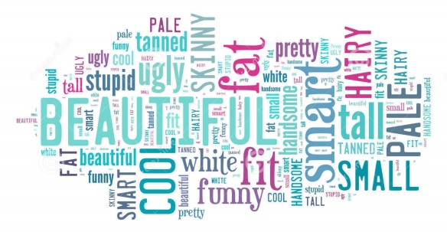
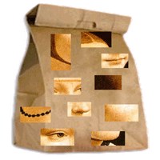
Object Recognition
How can we recognize objects?
What features to extract?
+ve?
-ve?
Object
Object
Extract Features
Train a classifier
Make Decision

Slide 6
What is Shape?

Slide 7

Notes:
What do we mean by shape?

Slide 8
“We here define ‘shape’ informally as ‘all the geometrical information that remains when location, scale and rotational effects are filtered out from an object.’”
– David George Kendall (1918-2007)
Statistician and Mathematician

Slide 9


Why use shapes?
No colour, no texture; yet recognizable.
Shape enables class-level recognition
How to represent shapes?

Slide 10
Outline
Introduction
Background
Perceptually Motivated Shape Context
What parts of a shape are discriminative?
Shape similarity propagation on manifolds
Object detection in images using shapes
Summary

Slide 11
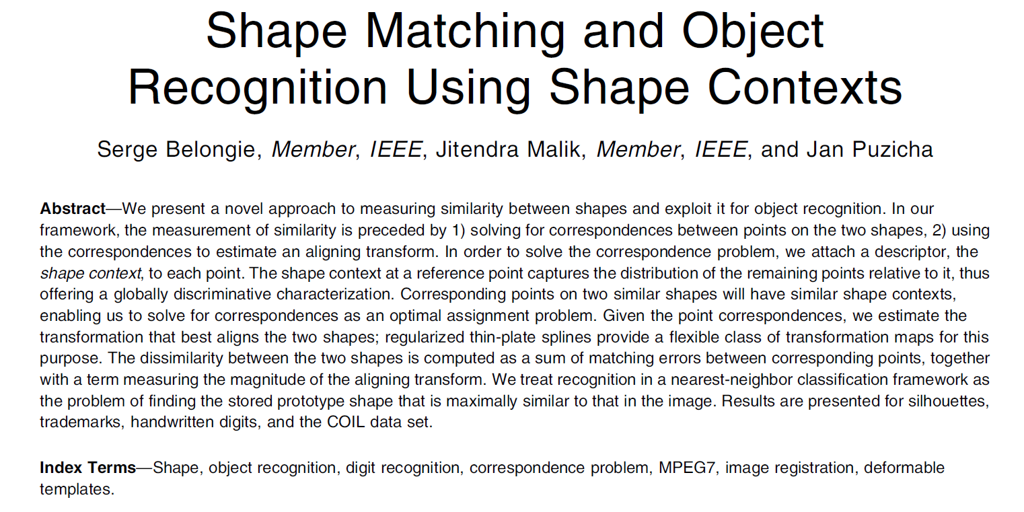
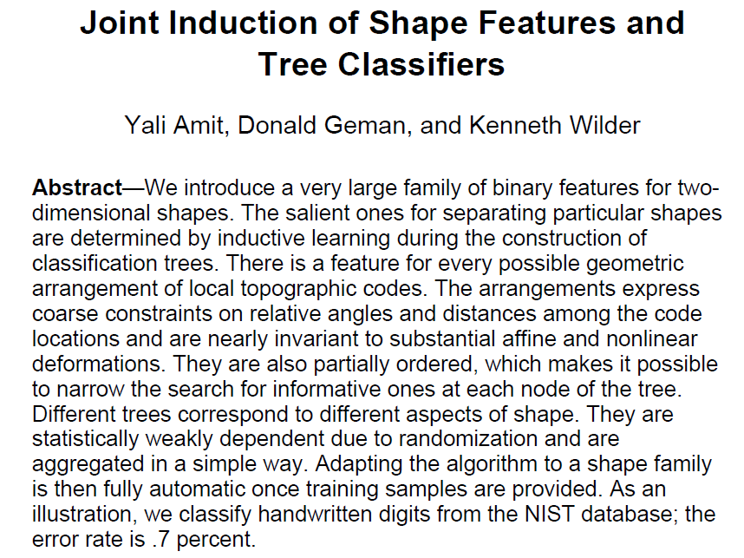
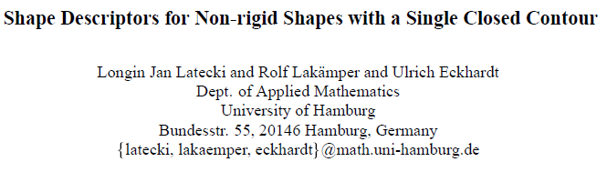
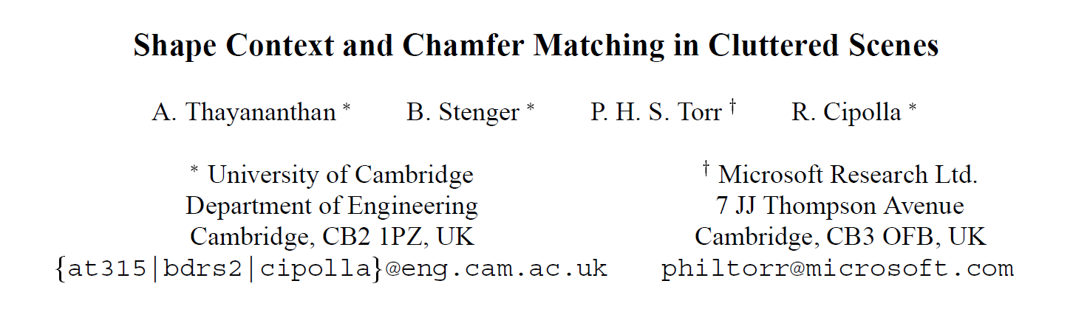
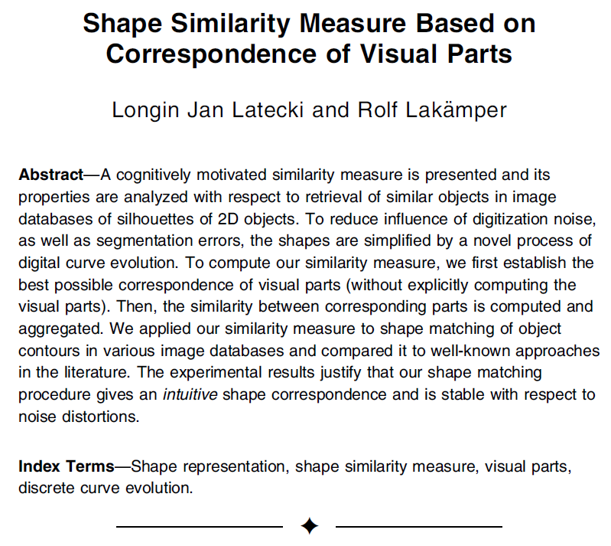
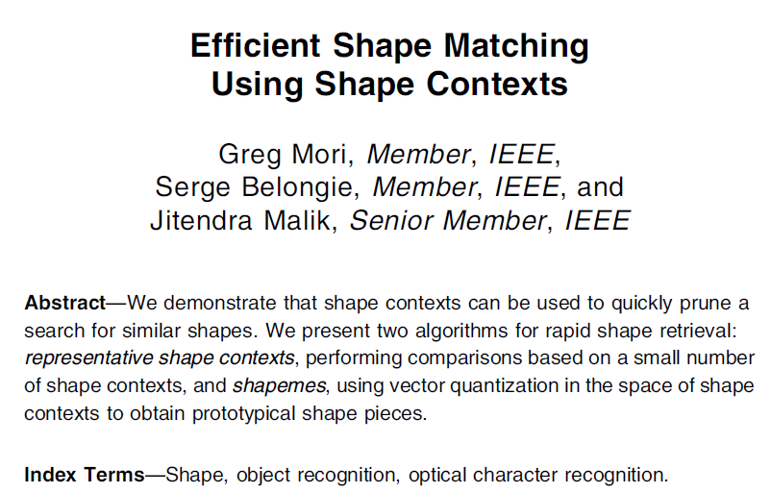
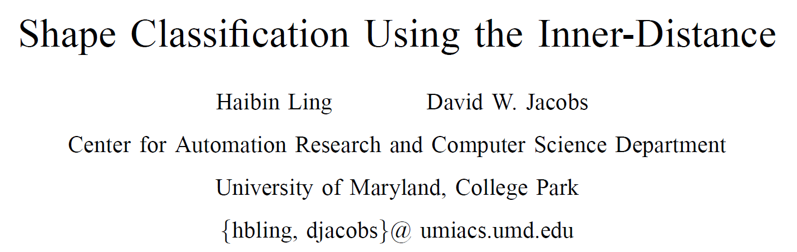
Modern Computer Vision

Slide 12
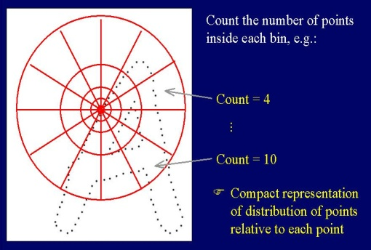
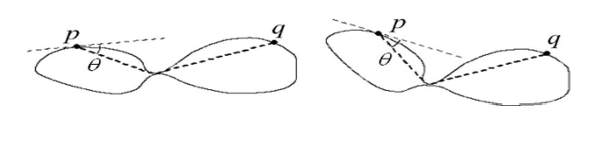
Existing Methods
Belongie, S.; Malik, J.; Puzicha, J.; , "Shape matching and object recognition using shape contexts," PAMI 2002.
Haibin Ling, David W. Jacobs, "Shape Classification Using the Inner-Distance”,
PAMI, 2007.
IDSC

Slide 13
Existing Methods
Belongie, S.; Malik, J.; Puzicha, J.; , "Shape matching and object recognition using shape contexts," PAMI 2002.
Haibin Ling, David W. Jacobs, "Shape Classification Using the Inner-Distance”,
PAMI, 2007.
IDSC
Reliance on perfect contours!

Slide 14

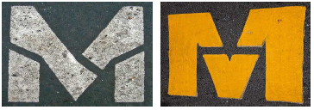
Issues with Contour-Based Techniques
Two assumptions of contour-based techniques
Noise-free contours
Closed contours
Contours are important, but not always
Need a way to capture entire shape; Gestalt Psychology
Interior properties of a shape play an important role
Contours have indentations and noise
Contours have breaks

Slide 15
Outline
Introduction
Background
Perceptually Motivated Shape Context
What parts of a shape are discriminative?
Shape similarity propagation on manifolds
Object detection in images using shapes
Summary

Slide 16
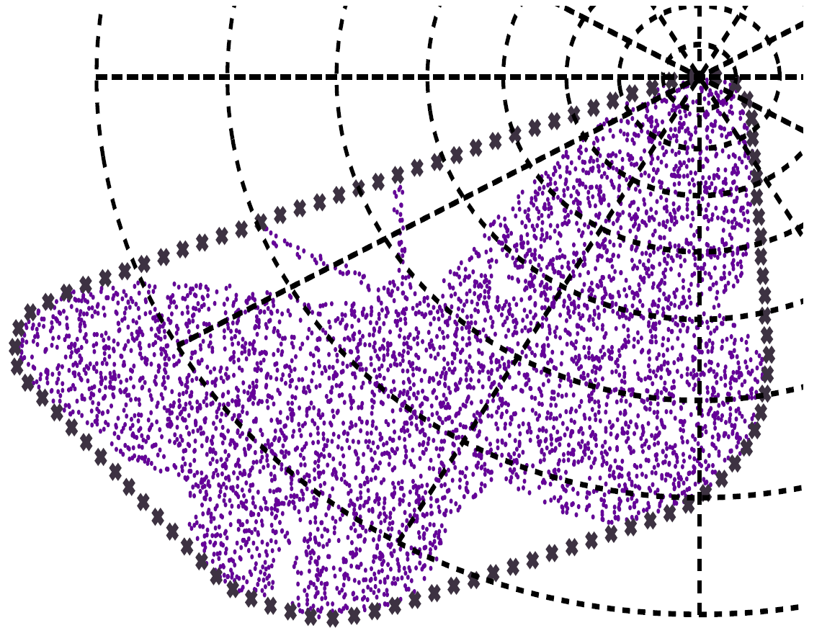
Solid Shape Context
Perceptually motivated variant of
the Shape Context Descriptor
Captures the interior properties of
the shape (Dense Points)
A sparse set of feature locations for
easy shape-matching (Sparse Points)

Slide 17
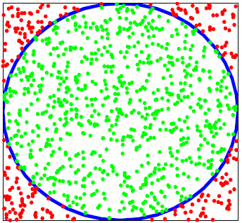

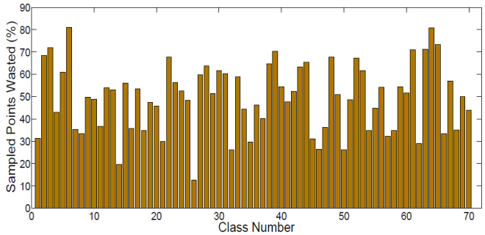
Interior Properties
Contour Layout: Sample contour :: Interior Layout :: Sample from inside!
How to sample points?
A: Accept/Reject technique

Slide 18



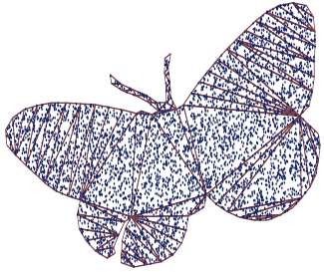
Constrained Delaunay Triangulation - Sampling
Extract contour and sample a set of points
Perform a Constrained Delaunay Triangulation
on the sampled points
Sample points from within each triangle

Slide 19
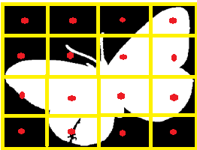

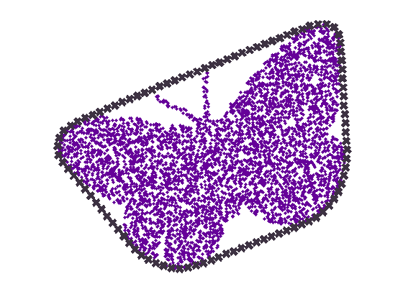
Sparse Points
Dense Points ~ 2500
Matching features are each Dense Point is computationally infeasible
(and unnecessary)
So, need a sparser set of points to compute the descriptor
What are a good set of sparse points?
Centers of grids?
We lose continuity
constraints
Uniform points along
contours?
Susceptible to
indentations in contour
Our method:
Sample points along the
convex hull of the shape

Slide 20
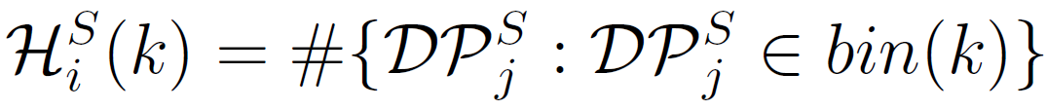
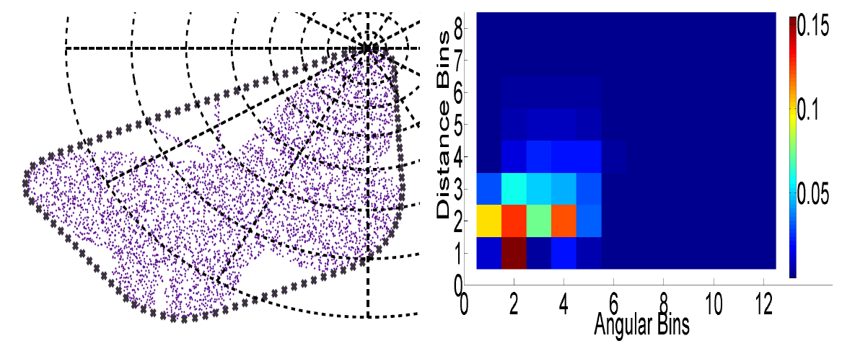
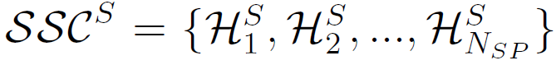
Solid Shape Context Descriptor
SSC descriptor is a 2-D histogram of distances and angles
The histogram is computed at each Sparse Point
A shape is now described by a set of histograms

Slide 21
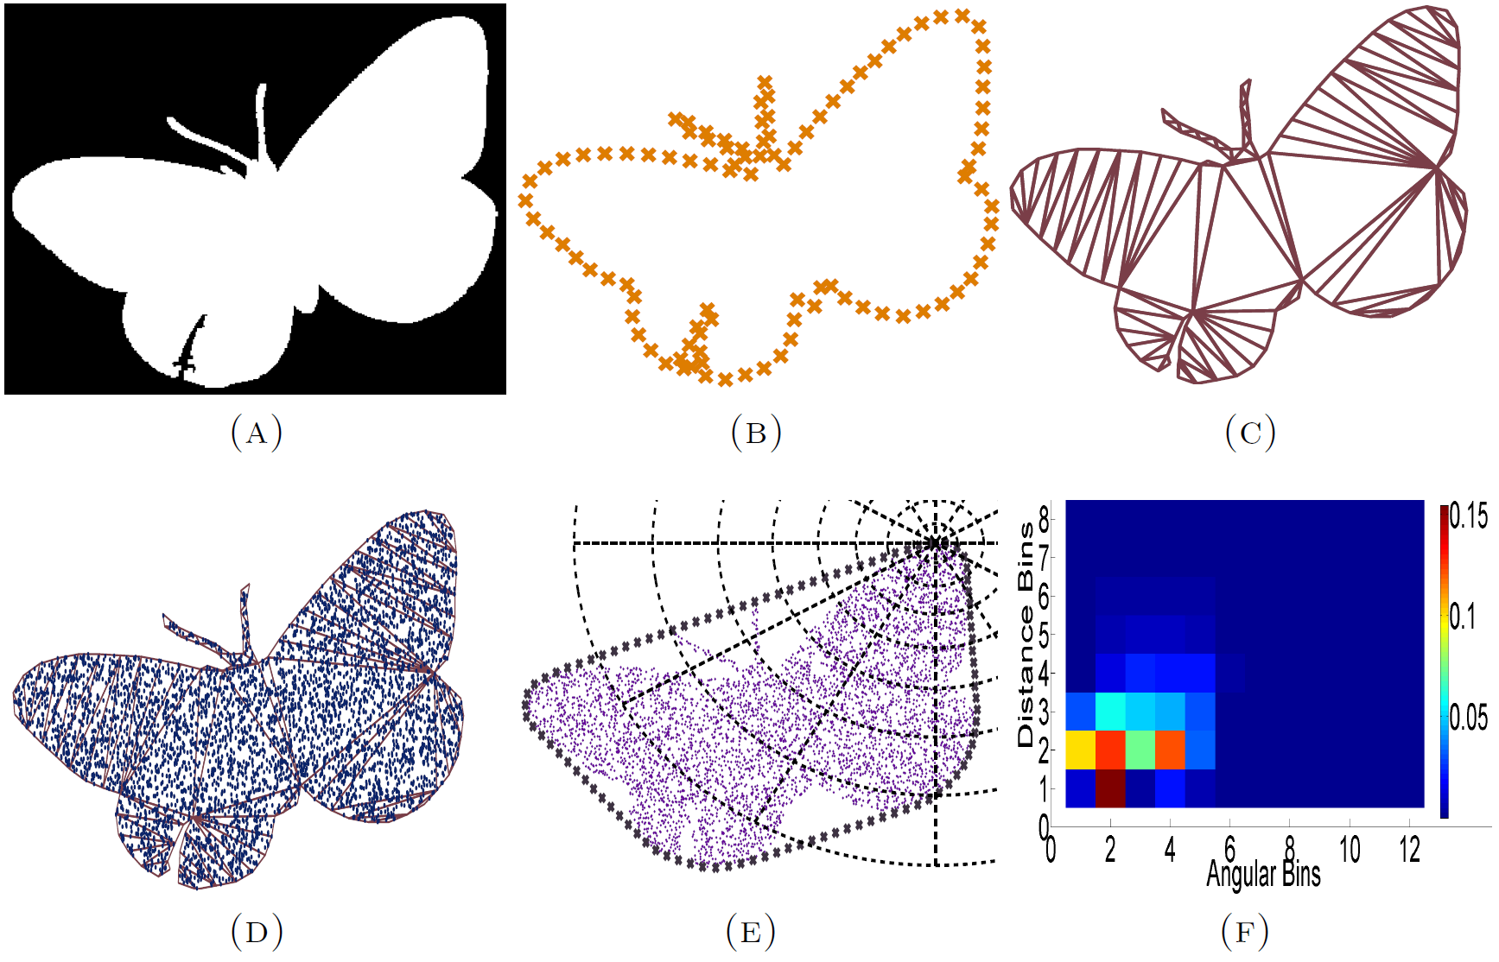
Putting it together

Slide 22
Properties of SSC
Robust to indentations and contour noise
Invariant to translation
Invariant to scale
Invariant to rotation

Slide 23
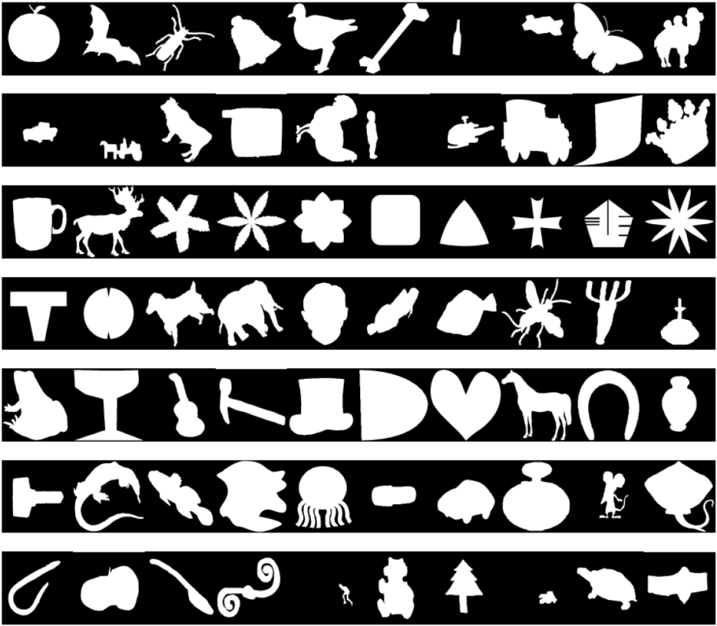
Experiments and Results
MPEG-7 Database
1400 images, 70 classes, 20 objects per class
Objects vary in scale, rotation, translation, articulation

Slide 24
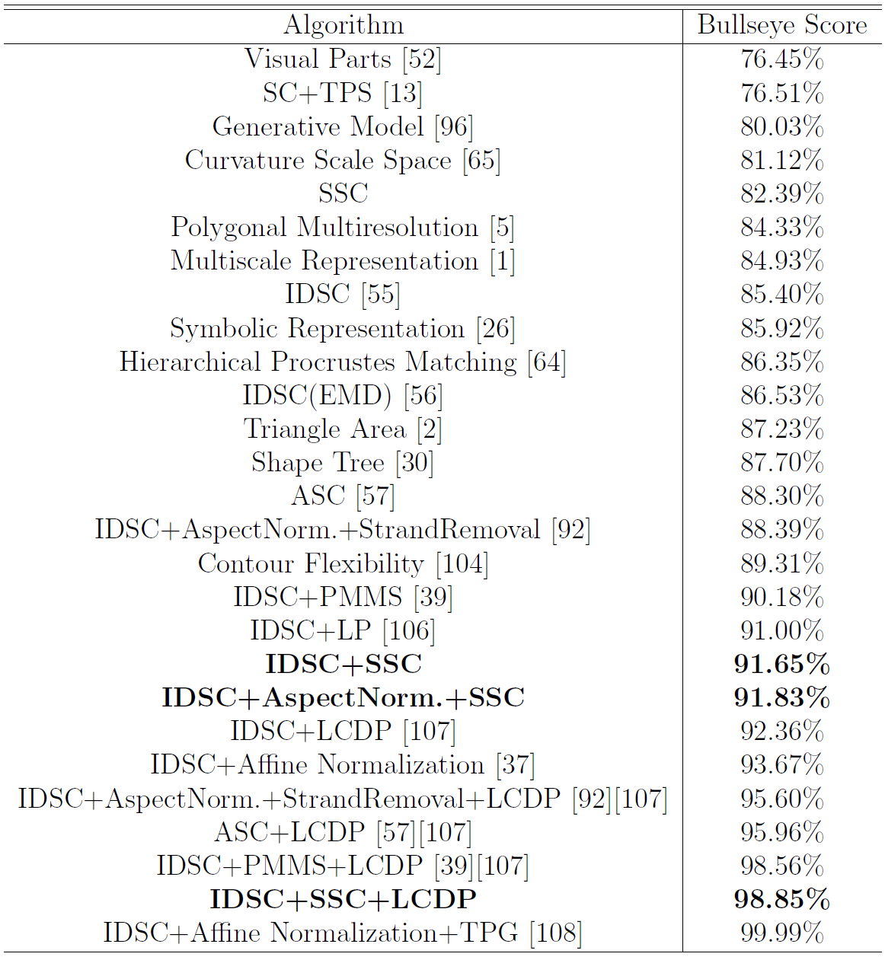
Experiments and Results
Performance is measured using Bullseye score

Slide 25
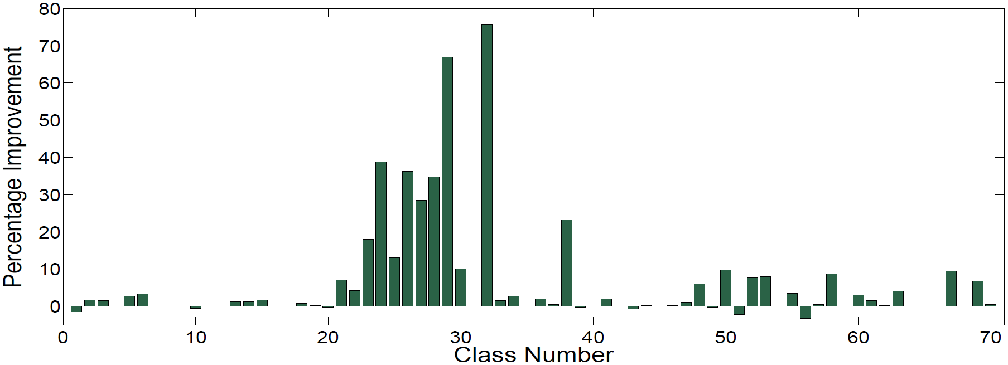
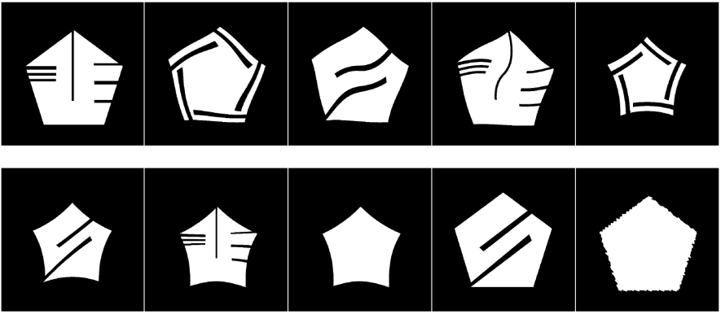
Improvement Over IDSC

Slide 26
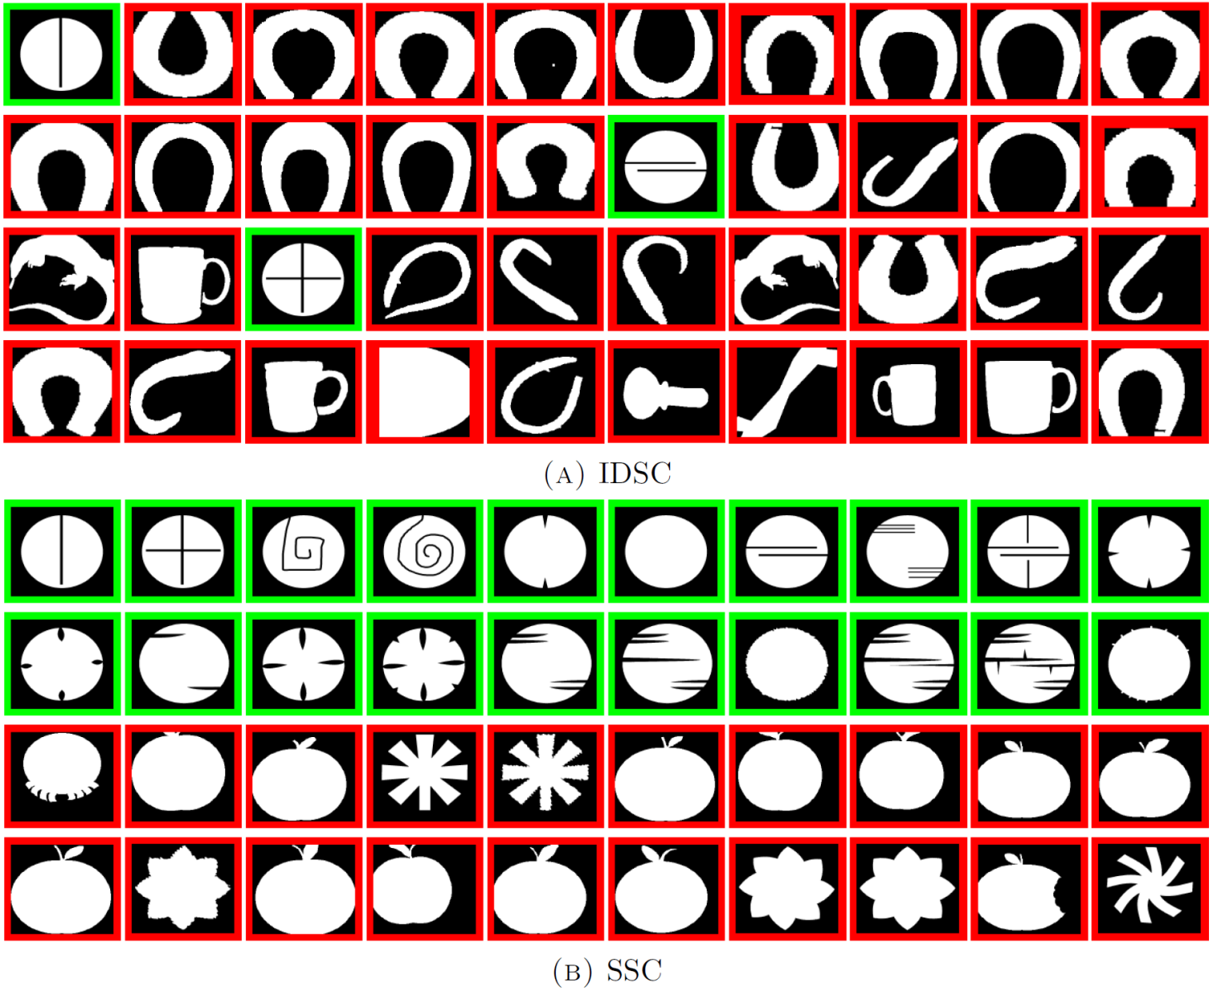
Qualitative Results

Slide 27
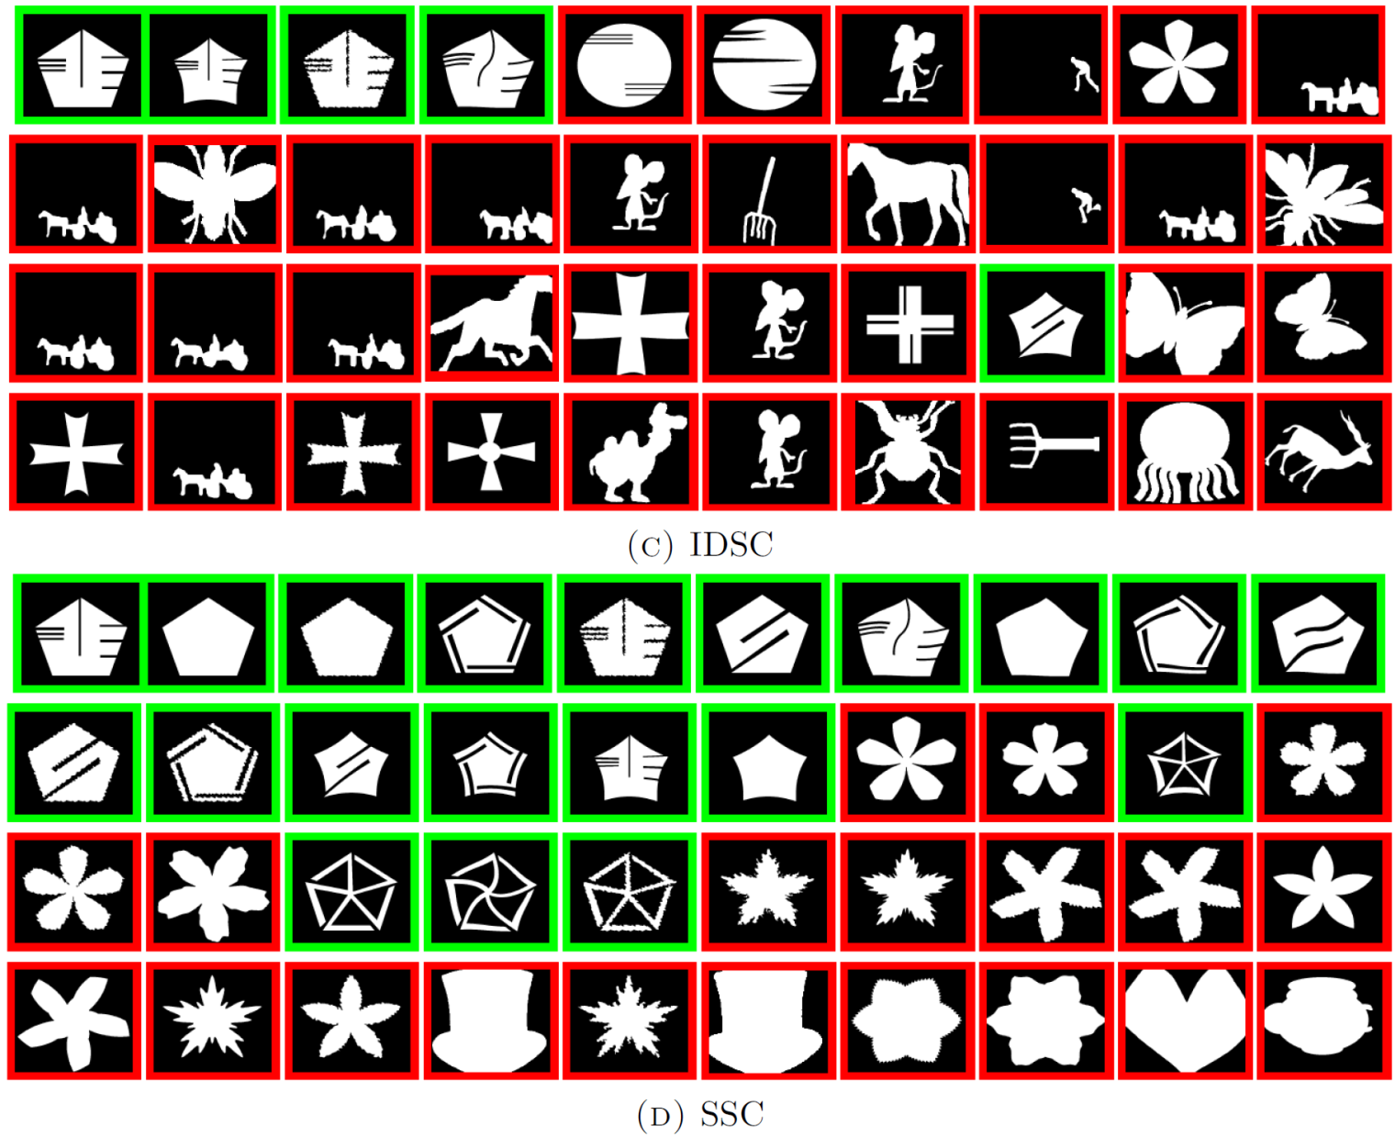
Qualitative Results - 2

Slide 28
Perceptually Motivated Shape Context - Recap
Interior properties of the shape are important
Proposed the Solid Shape Context descriptor to capture interior properties.
Vittal Premachandran, and Ramakrishna Kakarala. "Perceptually motivated shape context which uses shape interiors." Pattern Recognition (2013).
Ramakrishna Kakarala, Prabhu Kaliamoorthi*, and Vittal Premachandran*. "Three-dimensional bilateral symmetry plane estimation in the phase domain."Computer Vision and Pattern Recognition (CVPR), 2013 (* indicates equal contribution)
We assume that all parts of the shape are equally important.
Is it so?

Slide 29
Are all parts of the shape uniformly discriminative?

Slide 30
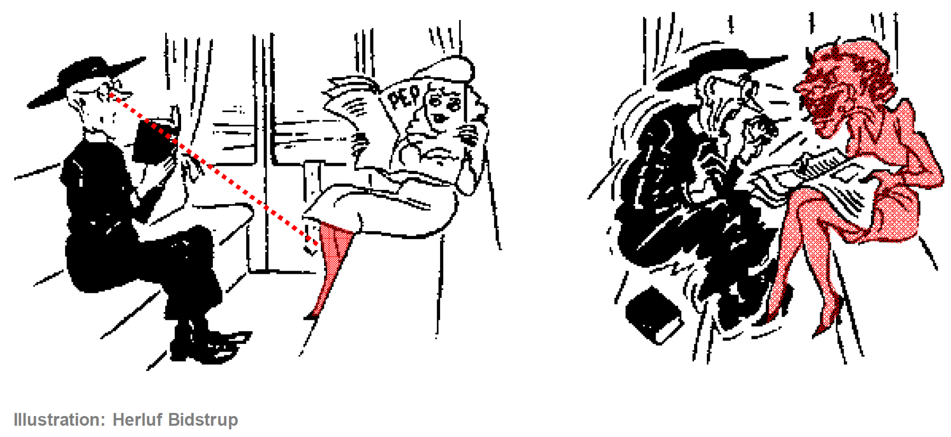

Slide 31
Outline
Introduction
Background
Perceptually Motivated Shape Context
What parts of a shape are discriminative?
Shape similarity propagation on manifolds
Object detection in images using shapes
Summary

Slide 32

Motivation

Slide 33
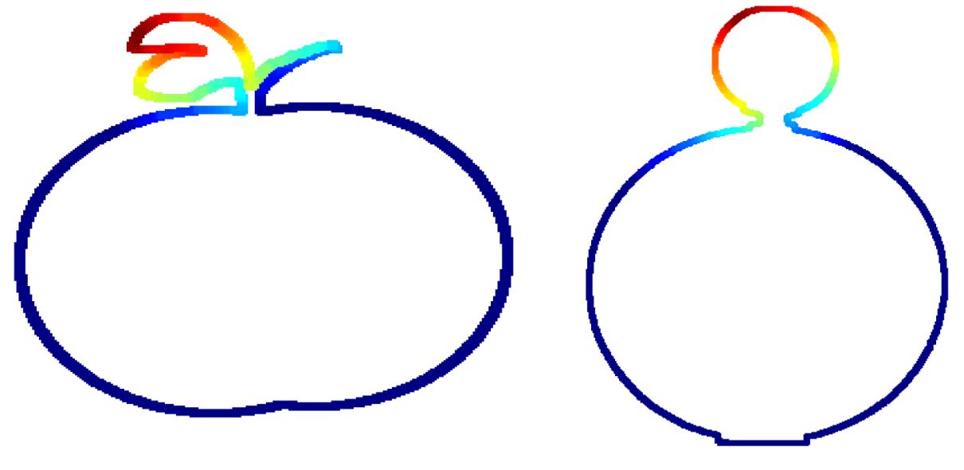
Motivation

Slide 34
Discriminative Parts
Definition: Parts of an object that are most different from parts of other objects belonging to similar-looking classes.
Identifying discriminative parts:
Divide the shape into multiple parts
Find how unique each part is, compared to the negative examples
Assign an importance score to the part, which is proportional to its uniqueness

Slide 35
Dividing the Shape
One way: Make cuts at points of extremum (i.e. corner points) on the contour
But, identifying extrema points is difficult and subjective.
Our approach:
Randomly split the contour into parts
Randomization does not introduce subjective bias
Bypass the use of not-so-perfect corner detectors

Slide 36
Dividing the Shape - Detail
Given a shape , extract its contour
Randomly split the contour into p contour segments
Repeat the procedure T times to get T sets of p random parts
Next step: Compute the uniqueness by comparing to parts from negative shapes
,
,
,…,
,
,

Slide 37
Compare Parts to Negative Shapes

Slide 38
Shape Descriptor
Requirements:
Invariant to translations
Invariant to rotation
Invariant to scale
Should be a partial shape descriptor! (Most important requirement)
SC, IDSC and SSC are all global shape descriptors

Slide 39
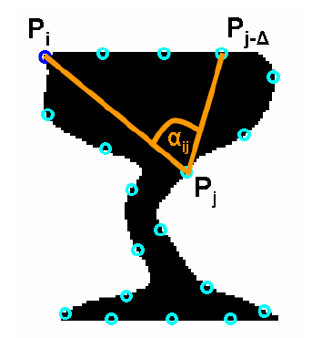
Shape Descriptor - 2
Donoser et al. “Efficient partial shape matching of outer contours”, ACCV 2009.
Figure from Donoser et al. ACCV ‘09
Any sub matrix of the above matrix, is a partial shape descriptor.
Distance: Distinctive
Distance: Distinctive

Slide 40
Example
Learnt distinctiveness for two confusing classes

Slide 41
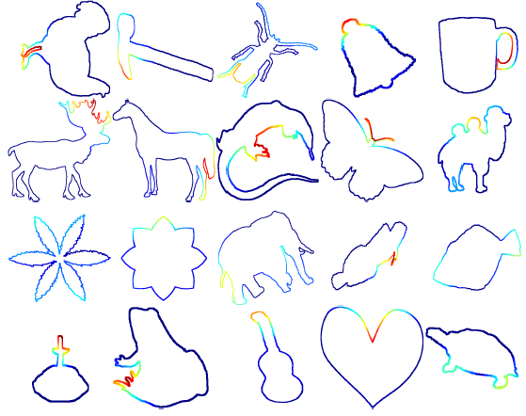
More Examples
Example heat maps from various classes.
Semantically meaningful parts are identified as being distinctive.

Slide 42



Part Consistency Matrix
Q =
Reference
Shape
Database
Shapes

Slide 43
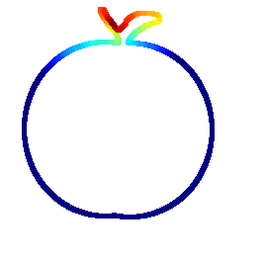
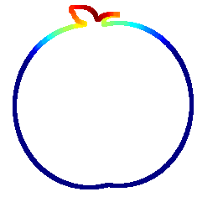
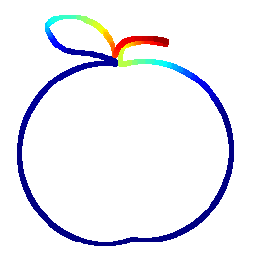

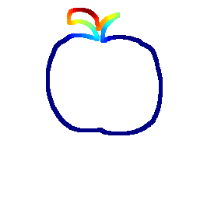
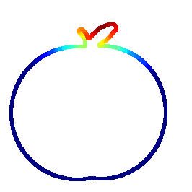
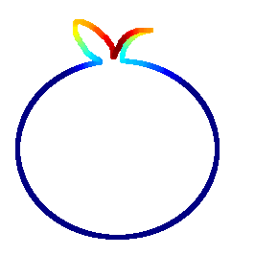
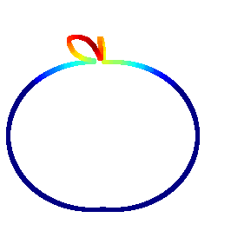
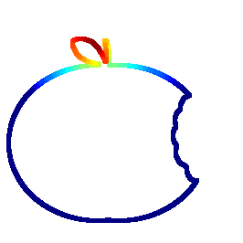
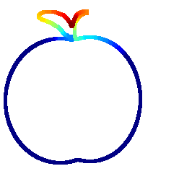










Example Class with Low AUC - Apples

Slide 44




















Example Class with High AUC – Face Silhouettes

Slide 45

Singular Value Curves

Slide 46
Summary
Introduced the concept of distinctiveness with a strong motivating example and provided a simple way to extract discriminative parts.
Vittal Premachandran, and Ramakrishna Kakarala. “What parts of a shape are discriminative?” IEEE International Conference on Image Processing, 2013. (Best Student Paper Award!)
Pairwise comparison.
Can we go Beyond Pairwise comparison of shapes?

Slide 47
Outline
Introduction
Background
Perceptually Motivated Shape Context
What parts of a shape are discriminative?
Shape similarity propagation on manifolds
Object detection in images using shapes
Summary

Slide 48

Shape Retrieval Using Shape Manifolds
Shapes lie in a high dimensional space
However, the shape manifolds are usually of lower dimensionality
Euclidean distance is a bad metric
Need to learn the “true” geodesic distances

Slide 49
Diffusion on Sparse Graphs
Diffusion is a process to learn the affinity between shapes
Sparse graphs are used for diffusion instead of fully-connected graphs
Fully connected graphs have lots of noisy edges;
Ways for graph sparsification:
K-NN graph neighborhood
Mutual K-NN graph neighborhood
Epsilon-NN graph neighborhood
Dominant neighborhood

Slide 50
Related work
Yang, Xingwei, Suzan Koknar-Tezel, and Longin Jan Latecki. "Locally constrained diffusion process on locally densified distance spaces with applications to shape retrieval." CVPR 2009.
LCDP for short
Uses k-NN for graph sparsification
Improves retrieval performance by ~6%
Xingwei Yang; Prasad, L.; Latecki, L.J., "Affinity Learning with Diffusion on Tensor Product Graph," IEEE Trans. PAMI 2013
TPG for short
Uses Dominant Neighborhoods (DN) for graph sparsification
Improves retrieval performance by ~6%
However, graph sparsification is performed in a supervised manner
For arbitrary neighborhood sizes, their performance drops (sometimes, drastically!)

Slide 51
Consensus of k-NNs
Intuition behind Consensus of k-NNs
Nodes that appear consistently in neighborhoods of other nodes have a high chance of being similar to each other
So, edges in the sparse graph should be between nodes that appear consistently
Prune edges between inconsistent nodes
Higher the value of ‘k’, higher the probability of adding noisy edges
Our approach is more robust at higher values of ‘k’

Slide 52

Consensus Information
Collecting consensus information is this simple!
Finally, retain the edge between p and q if C(p,q) > $τ$

Slide 53



Dominant Neighborhoods
Dominant neighbors are maximal cliques
Issues with DN:
False Neighborhoods
Disconnected Graphs

Slide 54

Neighborhood Comparison

Slide 55

Experiments
Toy Dataset: Spiral
Simple k-NN
Consensus of k-NNs

Slide 56

Experiments on MPEG-7 Database

Slide 57
Recap
Graph sparsification is important preprocessing step for diffusion
Consensus of k-NNs is a much more robust way of selecting neighborhoods
Vittal Premachandran, and Ramakrishna Kakarala. "Consensus of k-nns for robust neighborhood selection on graph-based manifolds." Computer Vision and Pattern Recognition (CVPR), 2013

Slide 58
Outline
Introduction
Background
Perceptually Motivated Shape Context
What parts of a shape are discriminative?
Shape similarity propagation on manifolds
Object detection in images using shapes
Summary

Slide 59



Object Detection Using Shapes
Object detection is a highly challenging task
Detection = recognition + localization
Two main approaches for object detection:
We aim to bridge the gap between the two approaches
HOG-based approach;
strong discriminative capability
Contour-fragment based approach;
strong localization ability

Slide 60

Our Model
Parts-based model
Each part denoted by two types of features:
Local features – HOG
Non-local features – Distance and Angle

Slide 61

Need For Non-Local Parts
Locally similar looking parts are highlighted in blue
Without non-local features, they can generate false matches

Slide 62

The Approach
TRW-S for optimization
Unary
Potential
Pairwise
Potential
Potts
Potential

Slide 63

Overall Procedure

Slide 64





Experiments and Results
ETH-Z Shape Database
5 classes
255 Images
PASCAL 50% overlap criteria
Performance measured by mean Average Precision and Detection Rate at 0.3/0.4 FPPI

Slide 65


Detection Examples

Slide 66

Mean Average Precision

Slide 67

Precision Recall Curves

Slide 68
Outline
Introduction
Background
Perceptually Motivated Shape Context
What parts of a shape are discriminative?
Shape similarity propagation on manifolds
Object detection in images using shapes
Summary

Slide 69



Summary
Presented a strong motivation to use shapes
Perceptually motivated technique to match shapes
Presented a novel technique for identifying discriminative parts.
Consensus of k-NNs for robust neighborhood selection
Bridge the gap between HOG-based and contour-based object detection

Slide 70
Future Work
Need other types of perceptually motivated techniques
Use discriminativeness of parts for generating better shape descriptors
Bigger shape databases are needed for object detection

Slide 71
Thank you!

